Slide 1
Investigating Discrimination in Algorithmic Hiring Decisions
Wen Xue
Supervisor:
Prof Philip Treleaven
Dr Zeynep Engin

Slide 2
There is a total of hiring decisions for 86644 applicants in the dataset, in which only 1476 applicants are hired. It is highly imbalanced.

Slide 3
To form a valid training set with features such as ‘IQ’, ‘Ambition’ and ‘Interpersonal’ scores, the rows with the scores missing are simply deleted because of the high missing rate 68%. The new ratio of hired and rejected candidates are shown above, which is still significantly imbalanced:

Slide 4
With A simple LogisticRegression classifier, the training accuracy score on the imbalanced dataset is 98.52%. The confusion matrix indicates that the classifier simply predicts all the entries as class 0.

Slide 5
To deal with the imbalance dataset, resampling and cost-sensitive techniques are tested. The PCA visualization of the imbalanced dataset is shown below:

Slide 6
Random undersampling: removing random samples from the majority class
Random oversampling: duplicating random samples from the minority class

Slide 7
Cluster-based undersampling: generating clusters of the majority class and replacing the clusters with the centroids of the clusters.
SMOTE(Synthetic Minority Oversampling TEchnique): pick a sample from the minority class and consider its k nearest neighbors and create a synthetic point.

Slide 8
The performance of logistic regression classifier after resampling:

Slide 9
Two different classifiers are used to construct the predictive model: Logistic Regression and Support Vector Machine.
Confusion Matrix, Precision score, Recall score, F1 score and AUC are used to measure the model performance.
Precision: True Positives/(True Positives + False Positives)
Recall: True Positives/(True Positives + False Negatives)
F1: 2*(Precision * Recall)/(Precision + Recall)
Precision indicates how precise is the model in predicting hired applicants while recall is the amount of hired applicants our model is able to detect. The F₁ score is the harmonic average of the precision and recall.

Slide 10
Logistic Regression test performance after Cluster Centroids resampling:

Slide 11
Logistic Regression test performance after Cluster Centroids resampling:

Slide 12
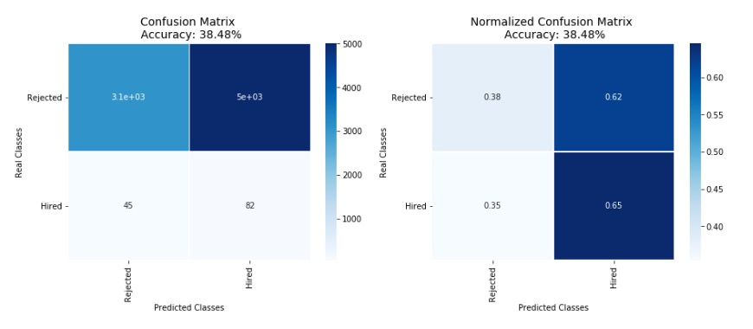
SVM test performance after Cluster Centroids resampling:

Slide 13
SVM test performance after Cluster Centroids resampling:

Slide 14
Cost-sensitive: take the misclassification cost into consideration by giving different weights to each class. The best AUC score for logistic regression occurs when give weight 60 to the minority class.

Slide 15
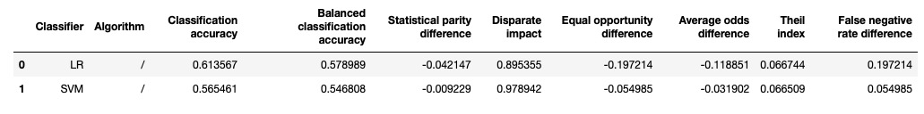
With the prediction of cost-sensitive logistic regression, the fairness metrics is calculated with respect to candidate gender.

Slide 16
Preprocessing Algorithms:
Reweighing

Slide 17
Reweighing is a preprocessing technique that weights the examples in each (group, label) combination differently to ensure fairness before classification.

Slide 18
After Reweighing:

Slide 19
Comparison of the original and new classification result with Logistic Regression:
Reduced balanced classification accuracy
Improved group fairness (Statistical parity difference, Disparate impact, Equal opportunity difference, Average odds difference)
Improved individual fairness (Theil index)

Slide 20
Comparison of the original and new classification result with SVM:
Improved balanced classification accuracy
Improved group fairness (Statistical parity difference, Disparate impact, Equal opportunity difference, Average odds difference)
Improved individual fairness (Theil index)

Slide 21
Preprocessing Algorithms:
Reweighing
Disparate Impact Remover

Slide 22
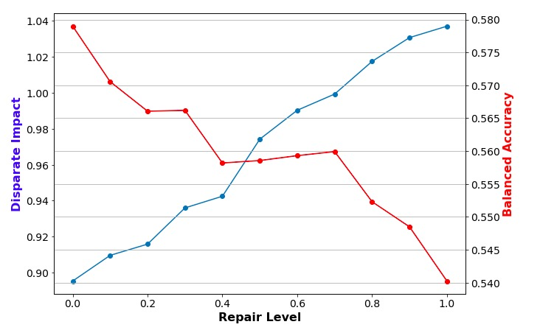
Disparate impact remover is a preprocessing technique that edits feature values increase group fairness while preserving rank-ordering within groups. A classifier learned from Y will not have disparate impact if X cannot be predicted from Y. A best repair level is selected to balance between fairness and utility.

Slide 23
Disparate impact remover is a preprocessing technique that edits feature values increase group fairness while preserving rank-ordering within groups. A classifier learned from Y will not have disparate impact if X cannot be predicted from Y.
The original data inputs sort by ‘iq’
The data inputs after repair(level=0.7) sort by ‘iq’ (the ranking didn’t change)

Slide 24
Comparison of the original and new classification result with Logistic Regression:
Reduced balanced classification accuracy
Improved group fairness (Statistical parity difference, Disparate impact, Equal opportunity difference, Average odds difference)
Reduced individual fairness (Theil index)

Slide 25
Comparison of the original and new classification result with SVM:
Reduced balanced classification accuracy
Reduced group fairness (Statistical parity difference, Disparate impact, Average odds difference)
Reduced individual fairness (Theil index)

Slide 26
Inprocessing Algorithms:
Adversarial Debiasing

Slide 27
Adversarial debiasing is an in-processing technique that learns a classifier to maximize prediction accuracy and simultaneously reduce an adversary’s ability to determine the protected attribute from the predictions.
The problem with the implementation of this technique is that it’s hard to compare with the performance of the plain model and other techniques. Moreover, maybe a preprocessed dataset without the class imbalance problem is needed for a better performance.

Slide 28
Postprocessing Algorithms:
Equalized Odds

Slide 29
Equalized odds postprocessing is a post-processing technique that solves a linear program to find probabilities with which to change output labels to optimize equalized odds.

Slide 30
Postprocessing Algorithms:
Equalized Odds
Calibrated Equalized Odds

Slide 31
Calibrated equalized odds postprocessing is a post-processing technique that optimizes over calibrated classifier score outputs to find probabilities with which to change output labels with an equalized odds objective

Slide 32
Postprocessing Algorithms:
Equalized Odds
Calibrated Equalized Odds
Reject Option Classification

Slide 33
Reject option classification is a postprocessing technique that gives favorable outcomes to unprivileged groups and unfavorable outcomes to privileged groups in a confidence band around the decision boundary with the highest uncertainty.

